Slide 1
GLOBAL LAYOFFS ANALYSIS
BY LINDA WACHIRA

Slide 2
Data Cleaning & Transformation
I cleaned and standardized 2000+ records by removing duplicates, handling NULL/blank values, correcting inconsistent text fields, and converting dates for analysis.
To see how I used various queries during this stage, please check the SQL scripts here.

Slide 3
EXPLORATORY DATA ANALYSIS
The following insights were drawn from the global layoffs dataset showcasing number of employees laid off each year since the year 2020, sparked by the rise of Covid 19.
The results are segmented by individual companies, industries, countries and stage.
We will also look at the top 5 companies that had the highest number of layoffs each year for the consecutive 4 years.

Slide 4
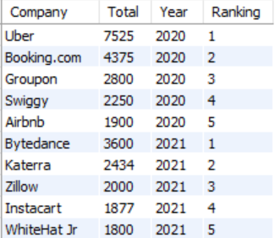
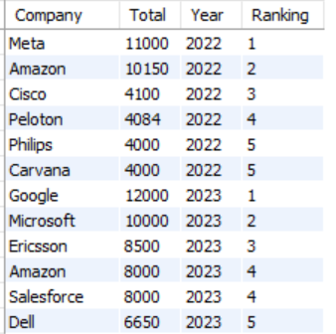
1. Top 5 companies with highest number of layoffs per year

Slide 5
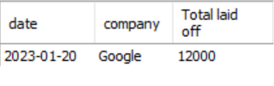
2. Company with maximum number of layoffs in a year
Of all companies listed, Google appears to have had the highest number of layoffs in the year 2023.

Slide 6
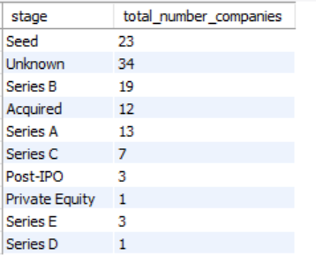
3. Companies that laid off all their employees
As you can see, quite a number of companies were forced to lay off all of their employees possibly shutting down.
Majority were in unknown stages, while the seed companies seem to have been greatly impacted by the wave as they were just starting out.

Slide 7
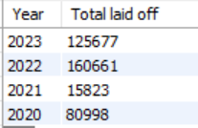
4. Total number of employees laid off per year
2021 had the least number of layoffs while 2023 had the most number of layoffs

Slide 8
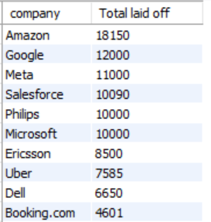
5. Total number of employees laid off per company(top 10)
The data clearly shows that very big companies fire employees the most compared to smalled ones, with Amazon taking the lead.

Slide 9
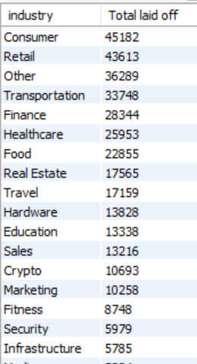
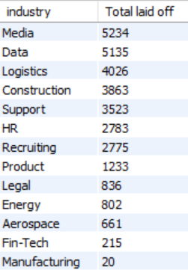
6. Total number of employees laid off per industry
Consumer industry suffered the biggest hit in layoffs while Manufacturing was the least

Slide 10
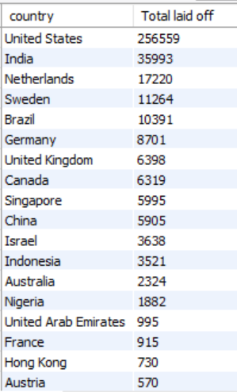
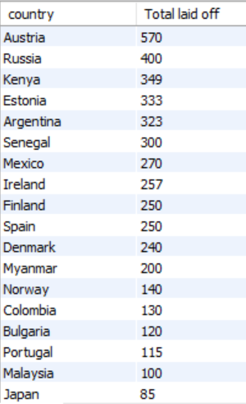
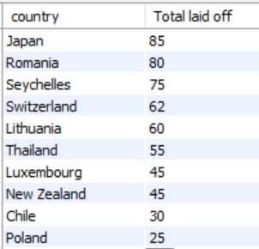
7. Total number of employees laid off per country
The United States laid off the highest number of employees than any other country in the world.

Slide 11
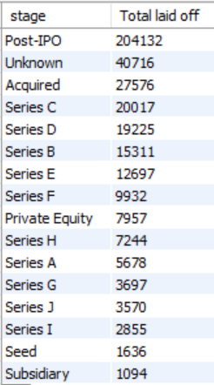
8. Total number of employees laid off per stage
Companies in the post-IPO stage including Amazon, Google, Meta, Microsoft just to name a few had the highest number of layoffs in total, while the sum that follows are unknown.
Subsidiary stage had the least number of layoffs.

